Slide 1

Algorithms & Data Structures
Week 3
recursion

Slide 2
Last two weeks we discussed…
Abstract data structures: Sets & Queues
Arrays & linked lists
Keeping data sorted – using the Binary Search algorithm
The two-pointer & sliding window technique
Algorithms typically consist of loops!
This week we’ll discuss how to program without loops ☺

Slide 3
Look, no loops!
What does this program print?
And the other one?
#include <stdio.h>
void count(int n) {
if (n != 0) {
count(n - 1);
}
printf("%d...", n);
return;
}
int main() {
count(5);
return 0;
}
#include <stdio.h>
void count(int n) {
printf("%d...", n);
if (n != 0) {
count(n - 1);
}
return;
}
int main() {
count(5);
return 0;
}

Slide 4
Look, no loops!
computing count(3)
computing count(2)
Recursion & call stack
computing count(1)
void count(int n) {
if (n != 0) {
count(n - 1);
}
printf("%d...", n);
return;
}
int main() {
count(3);
return 0;
}
computing count(0)
printf("%d...", 0);
count(0);
printf("%d...", 1);
0...
1...
2...
3...
count(1);
printf("%d...", 2);
count(2);
printf("%d...", 3);

Slide 5
Look, no loops!
computing count(3)
computing count(2)
Recursion & call stack
computing count(1)
void count(int n) {
if (n != 0) {
count(n - 1);
}
printf("%d...", n);
return;
}
int main() {
count(3);
return 0;
}
computing count(0)
printf("%d...", 0);
count(0);
printf("%d...", 2);
0...
1...
2...
3...
count(1);
printf("%d...", 2);
count(2);
printf("%d...", 3);

Slide 6
Look, no loops!
computing count(3)
computing count(2)
Recursion & call stack
computing count(1)
void count(int n) {
printf("%d...", n);
if (n != 0) {
count(n - 1);
}
return;
}
int main() {
count(3);
return 0;
}
computing count(0)
printf("%d...", 0);
printf("%d...", 1);
count(0);
3...
2...
1...
0...
printf("%d...", 2);
count(1);
printf("%d...", 3);
count(2);

Slide 7

Recursion vs loops
Why on earth would you use recursion to replace a loop?
With both recursion & loops, we iterate
  Loops: iterate over contents of a data structure
  Recursion: iterates over the smaller problems needed to solve a larger problem
Use recursion to Divide & Conquer

Slide 8
Iterating (sub)problems vs contents
Problem: printing (from 0) to N
Solution:
  Solve subproblem: print (from 0) to N – 1
  Then print N
#include <stdio.h>
void count(int n) {
if (n != 0) {
count(n - 1);
}
printf("%d...", n);
return;
}
int main() {
count(5);
return 0;
}
This is just a very simple subproblem!

Slide 9
Iterating (sub)problems vs contents
Problem: printing from N down to 0
Solution:
  First print N
  Solve subproblem: from N – 1 to 0
#include <stdio.h>
void count(int n) {
printf("%d...", n);
if (n != 0) {
count(n - 1);
}
return;
}
int main() {
count(5);
return 0;
}
Solution of the subproblem: N – 1 to 0 are printed

Slide 10
Applying recursion
Well-known examples

Slide 11
Binary search
Problem
solution: 0
0
Problem
67
solution : 0
mid:0
0
Problem: find value in sorted array
Approach:
  Try the middle
  Solve (sub)problem: find value in lower/upper half
Problem
41
67
solution : 1
1
mid:0
Problem
41
67
75
81
99
solution : 1
1
size_t find(
const int arr[],
size_t size,
int target)
mid:2
Problem
find 42
0
1
2
5
8
17
41
67
75
81
99
solution : 7
7
mid:5

Slide 12
Binary search – recursive implementation
size_t binary_search(const int arr[], size_t size, int target) {
if (size == 0) return 0; // insert at index 0
size_t mid = size / 2; // middle index
if (arr[mid] == target) {
return mid; // Target found
} else if (arr[mid] > target) {
return binary_search(arr, mid, target);
} else {
return mid + 1 + binary_search(
arr + mid + 1, // pointer arithmetic!
size - mid - 1,
target);
}
}
No loops!

Slide 13
When to use recursion?
One smaller problem must be solved to solve main problem:
Use iteration
Why is binary search easy to implement with a loop?
  Problem is reduced into 1 smaller subproblem
Problem
Problem
Problem
Problem
Problem
Problem
Problem
Problem
Multiple subproblems must be solved to solve main problem:
Use recursion
Problem
Problem
Problem
Problem
Problem

Slide 14
Evaluating expressions
An expression is made up of integers, parentheses, and operators *, +, %.
  Like this: "((2 * 18) % (2 + 7))"
Every expression is either:
  A single integer
  Or of the form (<expression> <operator> <expression>)
Can you solve this using iteration?
How about using recursion?
Result: 36 % 9 = 0

Slide 15
Evaluating expressions
Problem: evaluate expression (example: "((2 * 18) % (2 + 7))")
  Subproblem #1: Check if expression is or integer or more complex.
  Subproblem #2: Read left expression operand
  Subproblem #3: Read right expression operand
  Subproblem #4: Compute result
How to implement this?
  Try it yourself! (Assignment 2)
Easy
Recursion
Recursion
Easy

Slide 16
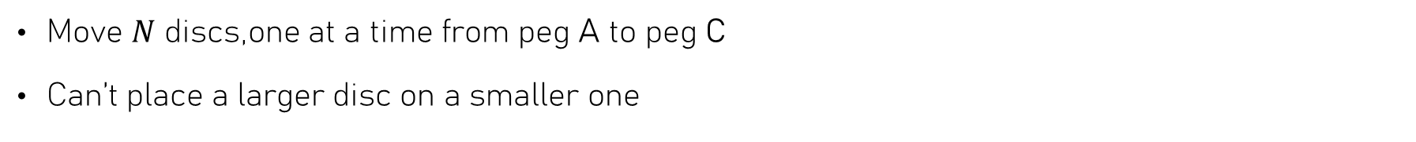
Towers of Hanoi
Move $N$ discs,one at a time from peg A to peg C
Can’t place a larger disc on a smaller one
Now write a program that solves this problem for any number of discs!
A
B
C

Slide 17
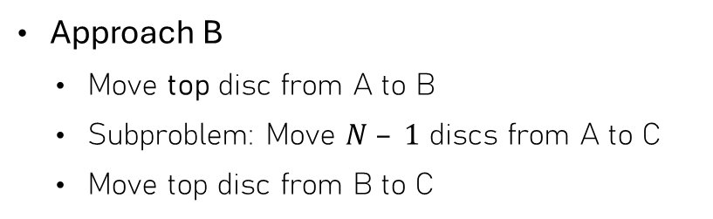
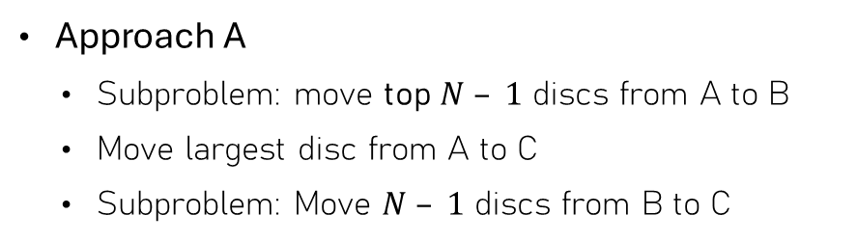
Towers of Hanoi – Move N discs from A to C
Approach A
  Subproblem: move top $N – 1$ discs from A to B
  Move largest disc from A to C
  Subproblem: Move $N – 1$ discs from B to C
Approach B
  Move top disc from A to B
  Subproblem: Move $N – 1$ discs from A to C
  Move top disc from B to C
Which one
works?
A
B
C
A
B
C

Slide 18
Towers of Hanoi – Approach A
// Print the solution to the Tower of Hanoi problem
// when moving n discs from peg 'from' to 'to'
// using the 'aux' peg as auxiliary storage.
void solve(int n, char from, char to, char aux) {
if (n == 0) return;
solve(n - 1, from, aux, to);
printf("Move disc from %c to %c\n", from, to);
solve(n - 1, aux, to, from);
}
To move N discs from peg A to peg C
  Move N – 1 discs from peg A to peg B
  Move top disc from peg A to peg C
  Move N – 1 discs from peg B to peg C
int main() {
solve(4, 'A', 'C', 'B');
return 0;
}
A
B
C

Slide 19
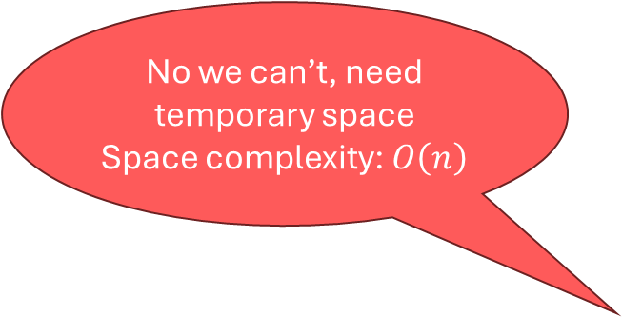
Divide & conquer: sorting
Divide sequence into two halves
Sort each part
Combine the two sorted parts
  “Merging”
42
1
0
99
77
67
41
18
21
13
Can we sort an array in-place in this way?
No we can’t, need temporary space
Space complexity: $O\left(n\right)$

Slide 20
Merge Sort
Sorting linked lists

Slide 21
Merge Sort
42
1
0
99
5
67
41
18
21
13
Partitioning: split list into two parts
Recursion
  Sort left half (using merge sort)
  Sort right half (using merge sort)
Combine solutions: merge

Slide 22

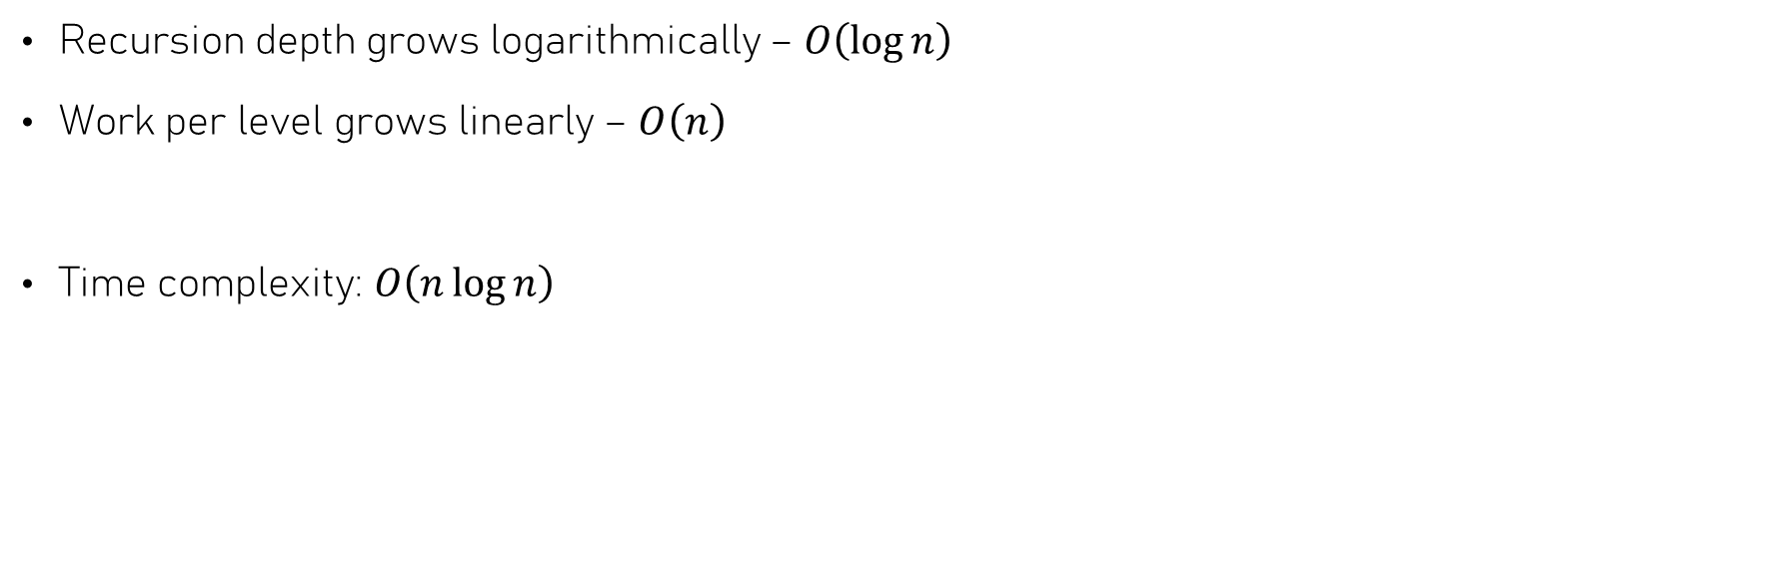

Merge Sort – time complexity
Recursion depth grows logarithmically – $O\left(\log{n}\right)$
Work per level grows linearly – $O\left(n\right)$
Time complexity: $O\left(n\log{n}\right)$
Work per recursion level: $O\left(n\right)$
Recursion depth:$O\left(\log{n}\right)$

Slide 23
Merge Sort – implementation
Node *merge_sort(Node *head) {
if (head == NULL || head->next == NULL) {
// Base case: list is empty or has one element
return head;
}
// Step 1: Split the list into two halves
Node *mid = split(head);
// Step 2: Recursively sort both halves
head = merge_sort(head);
mid = merge_sort(mid);
// Step 3: Merge the sorted halves
return merge(head, mid);
}
Problem: sort a linked list
Approach:
  If size is 0 or 1, no need to sort
  Split into two linked lists
  Sort both halves (Recursion!)
  Merge both (now sorted) parts

Slide 24
Merge Sort – splitting
How to split a list in two halves?
  Use two-pointer technique
/// @brief Splits a linked list into two halves.
/// @param head Pointer to the head of the linked list.
/// @return Pointer to the head of the second half of the list.
Node *split(Node *head);
slow
head
42
1
0
99
5
67
41
18
21
13
fast
result
(slow->next)

Slide 25
Quick Sort
Sorting arrays using divide & conquer

Slide 26

Quick Sort - partitioning
write points to location to store next element smaller than or equal to pivot
Now sort these “halves” recursively
write
Can’t just split array in two halves & sort halves
  Would need to “merge”
Instead, partition array into two parts
  Choose a value, say P – this is called the pivot
  Swap P into last position
  Keep all values smaller than / equal to P in lower part
    Move all other values to the end
43
1
0
99
77
42
11
5
21
67
read
Pivot: 42
When we’re done, write points to first element after pivot
Time complexity: $O\left(n\right)$

Slide 27
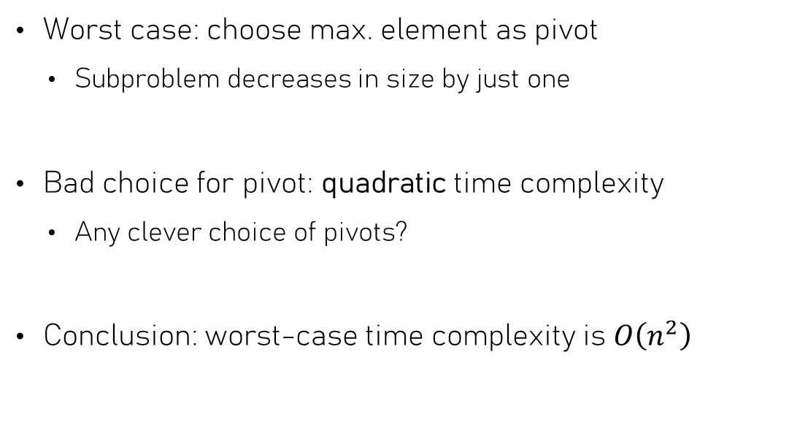
Quick Sort – time complexity
Worst case: choose max. element as pivot
  Subproblem decreases in size by just one
Bad choice for pivot: quadratic time complexity
  Any clever choice of pivots?
Conclusion: worst-case time complexity is $O\left(n^{2}\right)$
42
1
0
99
77
67
41
18
21
13
Pivot: 99
42
1
0
77
67
41
18
21
13
99

Slide 28
Time complexity
Recursion & logarithms

Slide 29
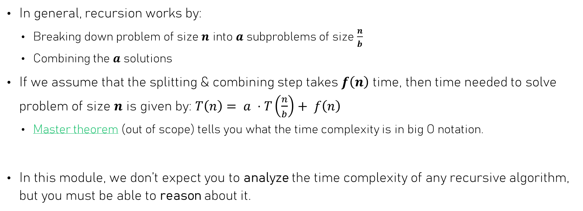
Recursion & Time Complexity
In general, recursion works by:
  Breaking down problem of size $n$ into $a$ subproblems of size $\frac{n}{b}$
  Combining the $a$ solutions
If we assume that the splitting & combining step takes $f\left(n\right)$ time, then time needed to solve problem of size $n$ is given by: $T\left(n\right)= a ⋅T\left(\frac{n}{b}\right)+ f\left(n\right)$
  Master theorem (out of scope) tells you what the time complexity is in big O notation.
In this module, we don’t expect you to analyze the time complexity of any recursive algorithm, but you must be able to reason about it.

Slide 30
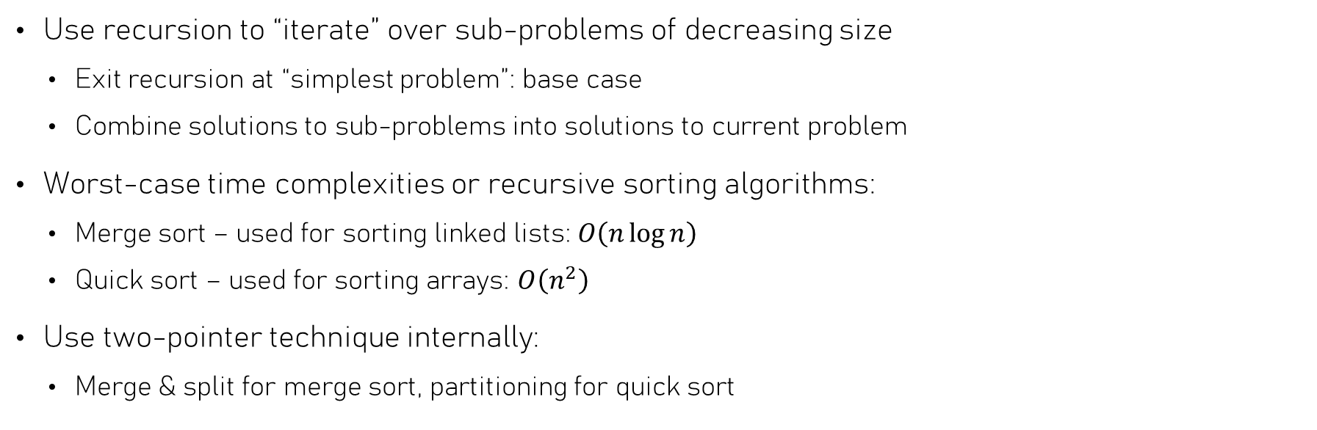
Summary
Use recursion to “iterate” over sub-problems of decreasing size
  Exit recursion at “simplest problem”: base case
  Combine solutions to sub-problems into solutions to current problem
Worst-case time complexities or recursive sorting algorithms:
  Merge sort – used for sorting linked lists: $O\left(n\log{n}\right)$
  Quick sort – used for sorting arrays: $O\left(n^{2}\right)$
Use two-pointer technique internally:
  Merge & split for merge sort, partitioning for quick sort

